Slide 1
Information Skills and Bibliographic Tools
Carole Wahnoun
October 8-9th 2026

Slide 2
Table of contents
1. Introduction
2. Approach to general documentary search and monitoring
3. Typical features of Scientific and Technological Information (STI)
4. Methodology of bibliographic search applied to the field of STI
5. Situational applications and practical work with paid or Open Access archives, databases and with free search engines and AI
6. Exploring the world of research articles
7. Conclusion

Slide 3
1. Introduction
Your expectations?
Target: to learn how to compose a bibliographic search report and to become more self-reliant in your documentary searches
Practice-based educational methods: situational applications, practice work and online examples
Topics addressed: the research issues of your master’s degree

Slide 4
2. Aproach to general documentary search and monitoring:
Definitions, purposes, typical and common features, differences and complementarity
Information types
Specific features of bibliographic search
Documentary search today for strategic and globalized information

Slide 5

“Information is the oil of the 21st century, and analytics is the combustion engine.” By Peter Sondergaard (Gartner Research)

Slide 6
Bibliography
Compiles all references for the documents used
Contributes to the quality of the work presented
Lends credibility to your work (by relying on validated information)
Must make it easy to locate the cited documents
Complies with copyright law

Slide 7
Definition and goals of documentary search methodology
“What is documentary research methodology?
Documentary research is the work of identifying, collecting and processing informative data on a given subject through the study of official or academic sources.
It is based on a method structured by stages which will make it possible to build a documentary research strategy. In a context marked by information overload, it is essential to apply a methodology to acquire reliable data on your subject.”
TBS Education, Ecole de Commerce et de Management

Slide 8
The engineer's five bodies of literature
Body of literature | When it becomes indispensable | Where to search
Journal and conference articles | State of the art, choosing a method, supporting a claim | OpenAlex, Scopus, Web of Science, IEEE Xplore, arXiv, HAL
Patents | Before any development, any filing, any competitive watch | Espacenet, data.inpi.fr, Lens.org
Standards | As soon as design, safety, testing or certification is involved | ISO, IEC, CEN/CENELEC, national bodies
Grey literature and reports | Realistic orders of magnitude, economic and regulatory context | ADEME, IRENA, NREL, IEA, HAL, OpenAIRE
Doctoral theses | The highest-yield entry point on a completely new subject | theses.fr, HAL, DART-Europe
Four of the five are absent from, or very poorly covered by, the classic bibliographic databases.
Notes:
Patents and standards get no lab in this format: this is where they are covered, in five minutes, with the method sheet handed to students.

Slide 9
^{Forms of Information}
Formal information
Written information
Information which has a digital or paper medium
Traded and published information : specialized newspapers, professional magazines, courses, scientific articles, patents, scientific and documentary databases, Internet
Informal information
Unstructured information without medium
Oral information
« What is told », information collected orally through exchanges
Company partners, inner or outer expert networks - Fairs and shows
Free information (most of the time)

Slide 10

^{Information} primary/ secondary
Primary source
  Publication at the source of information
  (article, patent, thesis…)
  Original information, as it was written by its author
Secondary, metatextual source :
description, analysis, assessment of primary information:
bibliographic record, summary, database catalogue…

Slide 11
Do you have
any questions ?

Slide 12
3. Typical features of Scientific and Technological Information (STI)

Slide 13
Specific STI documents
State-of-the-art, review of literature resulting from a literature search
Bibliometric analysis or assessment or studies (notion of quantification)
Research works, work documents
Patents
Specific standards and processes (e.g. : features and mechanical properties of some alloys) – Paid methodological guidelines
Free Open Archives if the authors have chosen a creative Commons Licence. and data warehouses
Benchmarks, and summaries of test beds for a product, a process, an alloy, for instance in the field of additive manufacturing.

Slide 14
A scientific article has its specific features
How can you get a good state-of-the-art or scientific review of literature ?
A literature search has to be targeted and based on an assessment / a selection.
  The assumptions, the presuppositions
  The issue, the specific problem you have to address
  The methodology and the approach to the problem
  The affiliations of authors (Laboratories, organizations in which they work)
  The summary (abstract)
  The references, the quotations of scientifically well-known authors, the bibliographical references
  Sometimes but not always, the DOI (Digital Object Identifier), the only document identity number.

Slide 15
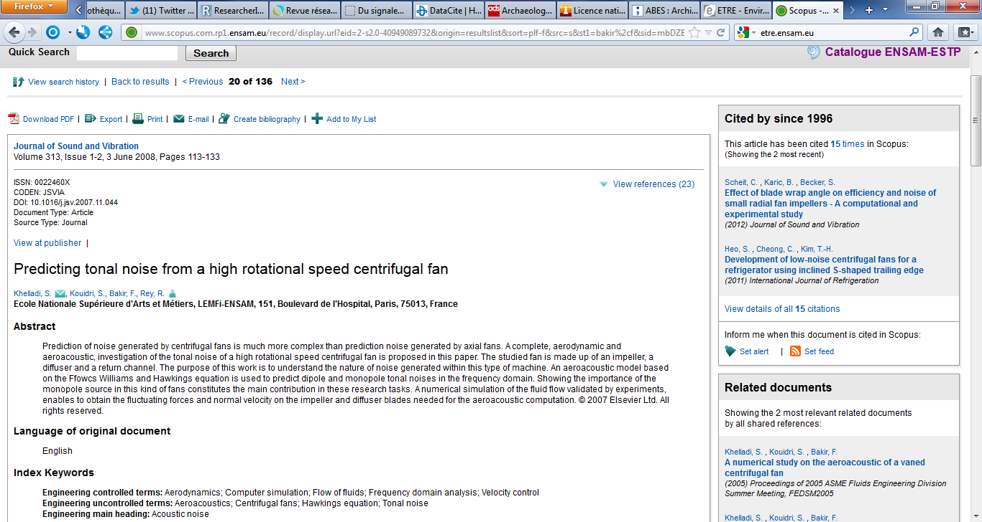
The quest for objectivity is an integral part of Scientific and Technical Information
Peer-review process : assessing and improving by peers,
contribution to the article to gain in popularity, objectivity and quality and work for its publication : example with the Supervisor of your Master’s work
2) Writing a metatext, a scientific text which relies on other scientific texts.
  Hence, the importance of :
  references, quotations of scientifically-known authors and bibliographic references within the article
  Putting together a state-of-the-art, a review of literature
  https://www-sciencedirect-com.rp1.ensam.eu/science/article/pii/S0257897218300823
  Scopus - Document Details

Slide 16
The globalization of Scientific and Technical Information : carried out on a world-wide scale
Query most of the main big databases and search engines preferably in English and often with Boolean operators in English
  Ex : You should query Google Scholar’s search engine in English.
  Purely French Techniques de l’ingénieur database is an exception to the rule even if the reference articles have been translated into English since 2024 (but be careful about the translation).

Slide 17
The promotion of knowledge via the library portal of Arts et Metiers campuses
The library portal of Arts et Metiers campuses is a prerequisite for you to make documentary, monitoring or literature searches, to look into its databases and to look for a document :
https://atrium.ensam.eu/
Sources, tools, databases (patents, standards, molecules, alloy grades) private and public servers, websites, hyperlinks…..
Typical dissemination, promotion and enhancement modes, paid servers, Open Science archives, academic search engines, scientific events and exhibitions …

Slide 18
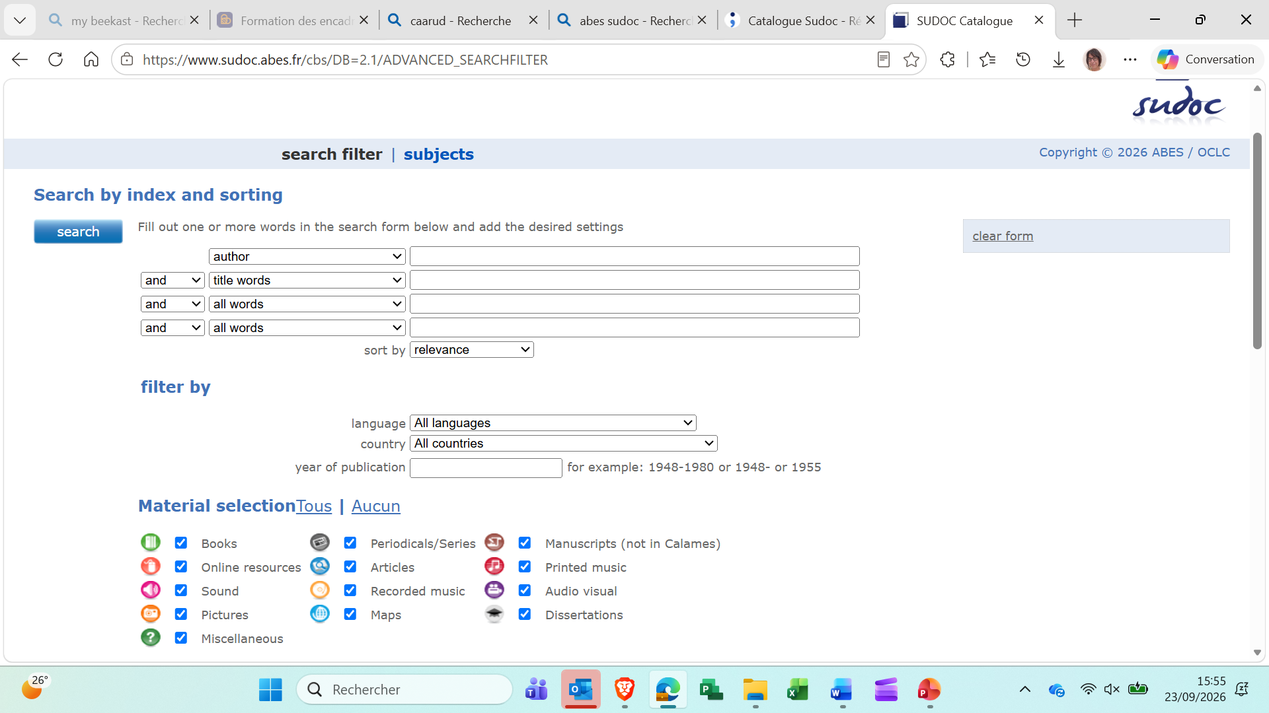
https://www.sudoc.abes.fr/
Higher Education Union Catalogue
(15 millions bibliographic records, all document types)

Slide 19
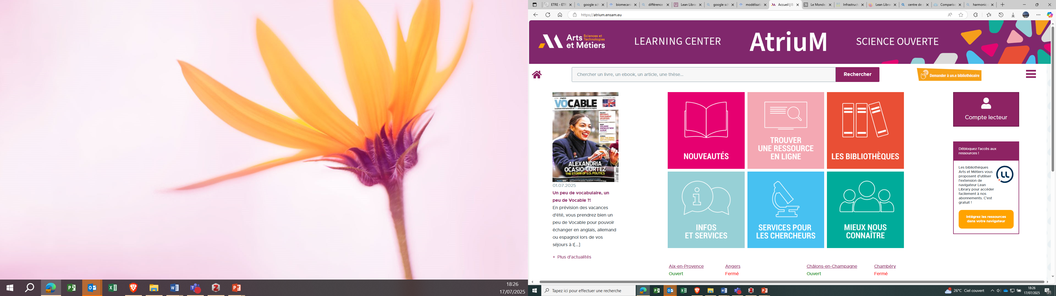
^{Documentary ressources}
https://atrium.ensam.eu/

Slide 20
Do you have
any questions ?

Slide 21
4. Methodology of bibliographic search applied to the field of Scientific and Technical Information

Slide 22

Quote your references!
Why?
→ For intellectual honesty
→ To find the references used
→ To respect the copyright
otherwise :
Plagiarism

Slide 23
Why is it relevant to do a bibliography ?
To base one's reflection on scientifically recognized authors
To produce a verifiable study
To allow the reader to delve deeper into a subject
Methodology:
as work progresses
use of bibliography software (to be discussed later)
A bibliographic citation is a form of brief reference placed in parentheses within the text or appearing as a footnote.

Slide 24
The fundamentals of bibliographic search
Definition
    Issue
    Purposes
    Assumptions,
    Scope, perimeter of the search (targeted search)
    Stakes
    Methodology and approach to the issue
    Method
    documentary search is based upon experience and an empirical method just like scientific enquiry : you often have to grope in the dark, as you do in the research field. There are often several ways and means to reach the results.
    Documentation language
    Most of the paid databases have to be queried in documentation language more rigorous than natural language : AND and NOT are not used in the same way in the two languages
Steps of document research
Define the topic (go from general to specific) ;
Identify the key concepts ;
Choose keywords and search terms ;
Select research tools ;
Search for and analyze content ;
Sort the results ;
Organize references ;
Produce a summary.

Slide 25
Steps of bibliographic search (1)
From an example in a state-of-the art about metal additive manufacturing
Background : you have to file a patent for a new process deposit
Review of the situation, review of literature, state-of-the-art (assessment, analysis of what already exists), needs, requirements analysis
Sourcing and upstream monitoring: benchmark, critical analysis, cross-checking, combining, collecting paper and digital sources, tools (servers, databases and search engines)
(Entry gate to research: Scopus or Google Scholar)
Designing the search strategy, syntax and equation
(innovation AND “engineer ") (Google Scholar)
“innovation" AND ( engineer OR review ) (Scopus)
Documentary processing : analysis, synthesis and assessment of search results : The information has to be assessed with high added value, it must enable you to capitalize knowledge, to provide strategic decision support, to feed your research work, your master dissertation.

Slide 26
The eight checkpoints of a clean record
Thirty seconds per record. Skipping the check costs half a day of rework before submission.
1
Item type
2
Authors
3
Title
4
Source
Article, conference paper, chapter, thesis, report, patent, standard.
“Last, First” format, one per line, without “et al.”.
Consistent capitalisation, no stray capitals inherited from the export.
Journal or conference, volume, issue, pages — complete.
5
Year
6
Identify
7
Language
8
Attachment
The year of publication, not the year it went online.
DOI or equivalent persistent identifier, where one exists.
It drives the typographic rules of the citation style.
It opens — and it is the right document.
De-duplication is done by merging, never by deleting: merging preserves the attachments and notes of both records.
Notes:
Citing: IEEE style in the preferences, word processor plugin for Word or LibreOffice, Better BibTeX for the LaTeX workflow. Never edit a bibliography by hand.

Slide 27
Evaluate sources
Others useful and reliable sources on internet:
Reliable sources
News : AFP - Plateforme de l'info
Legislation : Legifrance
Health : Institut national de la santé et de la recherche médicale
Sciences et technics : CNRS, Inria, CNES, etc.
Economy : Insee
Ancient documents : Gallica

Slide 28
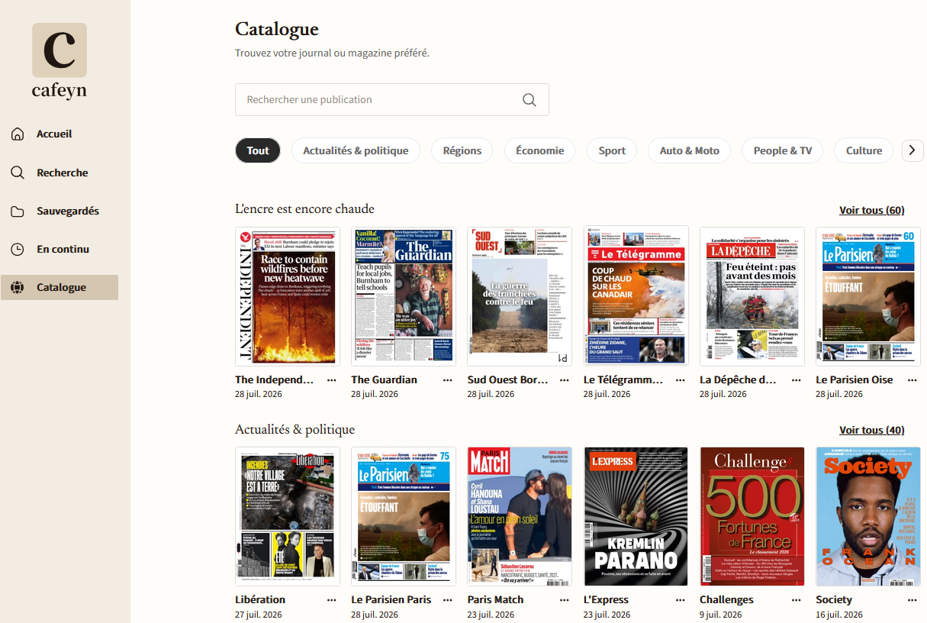
Where to search for press articles?
Atrium.ensam.eu
Cafeyn

Slide 29
Steps of bibliographic search (2)
(From an example in a state-of-the art about INNOVATION IN ENGINEERING :
Background : you have to file a patent for a new process deposit
Communicating, restituting, returning, disseminating, promoting and enhancing search findings through
your Master’s dissertation in particular to your Supervisor and to other researchers (your thesis or dissertation defence),
Possibly, setting up a scientific and technological watch or an economic, normative, environnmental, regulatory or strategic monitoring on the issue, to go further, to keep a permanent or active watch over novelties and developments and be ahead of others in this field in a logic and a quality drive of continuous improvement
(Some tips for setting up and keeping a watch with Google Scholar)
(“innovation” AND “engineering”)

Slide 30
Designing the search equation, syntax and strategy (1) Principles and methods
Highlight the issue (as a too long equation according to search engines and databases, will either return no results or will be badly interpreted)
Be rigorous : pay attention to the search syntax, to spaces, to the langage, to parentheses, to truncations, to upper case letters for Boolean operators (or they could be regarded as semantic words), as if you were dealing with a mathematical equations, remove all accents and favor the singular form
Analyse the meaning of words and phrases and think of synonyms and of various scripts of a word or a phrase

Slide 31
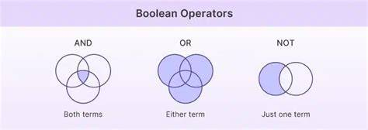
Designing the search equation, syntax and strategy – (2) : methods
Boolean operators : AND, OR, NOT (or AND NOT) in English : use capital letters
  OR : useful for synonyms or spell diferences
  AND : to combine ideas and concepts, make the results less numerous,
  NOT : use cautiously, to be more accurate

Slide 32
Truncations : a question mark ? to replace 0 or 1 character: bike? for bike (singular) or bikes(plural) - asterisk * to replace n characters: comput* for computer, computing, computerize
Quotation marks to confine the search of a phrase to the exact phrase. They make the research much more precise. Do not use chevrons « »; use straight quotes " ". Never insert a truncation in a phrase in quotation marks. Never put a single word between quotation marks.
Distributive parentheses (As in mathematics in order to combine Boolean operators) . AND always has priority over OR or NOT.
Spaces : insert spaces between parentheses and keywords, between keywords and boolean operators
“innovation" AND ( engineer OR review ) (Scopus)

Slide 33
Citations and norms
Norms of citations : follow the advice of your teachers to choose the useful one for your work.
Some websites which can help you :
Free Citation Generator - APA, MLA, Chicago | Grammarly
Overview - Citation Styles: APA, MLA, Chicago, Turabian, IEEE - Guides at University of Pittsburgh
Bibliography.com - Free citation and bibliography generator.
Sorting of references, your choice:
alphabetical order by author
e.g.: PEREC, Georges. La Disparition. Paris: Gallimard, 1989. 319 p.
by order of appearance in the text (Vancouver system)
e.g.: [01] PEREC, Georges. La Disparition. Paris: Gallimard, 1989. 319 p.
by chronological
by document type (books, periodical articles, dissertations, theses, videos, etc.)
by theme

Slide 34
Putting together a bibliography:
methodology
Some pieces of advice
Selection of scientifically well-known authors
Consistency in the presentation of document types
Consistency in the classification of references
    Alphabetical classification by author (Harvard)
    Classification by order of appearance in the document (digital system)
Possibility of using Zotero, free Open Source software to export, to transfer the references and to carry out a bibliography

Slide 35
Quotations in the text
^{The Harvard system}
The results of the first study (Woodhouse, 2018a) were inconclusive, but a follow up study (Woodhouse, 2018b) achieved a clearer outcome.
You quote and put in square brackets the author’s name followed by the article’s publication year. If you quote several publications from the same author, for the same year, you have to add a, b, c, d after the publication year.

Slide 36
Harvard referencing examples
Book :
Author surname, initial. (Year) Book title. City: Publisher.
Smith, Z. (2017) Swing time. London: Penguin.
Journal articles :
Author surname, initial. (Year) ‘Article title’, Journal Name, Volume(Issue), pp. page range.
Thagard, P. (1990) ‘Philosophy and machine learning’, Canadian Journal of Philosophy, 20(2), pp. 261–276.
Websites :
Author surname, initial. (Year) Page title. Available at: URL (Accessed: Day Month Year).
Google (2019) Google terms of service. Available at: https://policies.google.com/terms?hl=en-US (Accessed: 27 January 2020).
A Quick Guide to Harvard Referencing | Citation Examples

Slide 37
Where to find your vocabulary
BLOCK A · STRATEGY
Never invent it alone: it is already written down somewhere.
1
The database thesaurus
2
Titles and abstracts
Where one exists — Inspec, Compendex — it is the highest-yield source and the most ignored.
Of three or four key articles already identified: the community's vocabulary can be read straight off them.
3
Author keywords
4
Patent terms
They give the living variants of the field, the ones that have not yet reached the thesaurus.
Often different from academic vocabulary for exactly the same thing. The most neglected source.
Notes:
Run the exercise live on the demonstration topic, two minutes, before launching the lab.

Slide 38
Precision, recall, and the log
BLOCK A · STRATEGY
The trade-off
The five fields of the log
▪ Precision: share of relevant results among those obtained.
▪ Recall: share of the relevant literature actually retrieved.
▪ The two cannot be maximised together: broadening raises recall and degrades precision.
▪ The engineer's rule: favour recall on the “technical solution” facet, accept the noise, then screen. Missing a competing process costs more than reading thirty useless abstracts.
▪ The database and its interface.
▪ The date.
▪ The exact query, as executed.
▪ The filters applied.
▪ The number of results obtained.
▪ Without these five fields nobody can replay the search — including you, three months from now.
The log is filled in during the work, never afterwards: a reconstructed log is a reconstruction.
Notes:
This is the habit that best survives leaving school. It only costs the time it takes to explain it.

Slide 39
The grid — six criteria
A score not backed by the measurement described does not count.
# | Criterion | Measurement protocol | Scale
1 | Recall against the gold-standard corpus | How many of the 25 gold-standard DOIs appear in the tool's first 50 results | 0: < 20% — 1: 20-39% — 2: 40-59% — 3: ≥ 60%
2 | Validity of the references | Share of cited DOIs that resolve, measured with verif_doi.py | 0: < 70% — 1: 70-89% — 2: 90-98% — 3: 99-100%
3 | Faithfulness of claim ↔ source | Five claims drawn at random: does the cited source support the point? | 0: 0-1 of 5 — 1: 2 — 2: 3-4 — 3: 5 of 5
4 | Transparency of the query | Is the query actually executed displayed? correctable? re-runnable? | 0: nothing — 1: vague summary — 2: displayed — 3: displayed and editable
5 | Interoperability with Zotero | RIS or BibTeX export then import: check five records, count the fields lost | 0: no export — 1: degraded — 2: correct — 3: faithful
6 | Confidentiality | Where do the data go? Can I put an internship subject under an NDA into it? | 0: incompatible — 1: unclear — 2: clear terms — 3: 100% local
The full ten-criterion grid is in Appendix B of the syllabus. The other four cover precision, coverage, reproducibility and cost.
Notes:
Criterion 3 is the one students discover here. Take the time for the example: a source that exists, that is relevant, and that does not support the sentence.

Slide 40
Do you have
any questions ?

Slide 41
Databases,
Scopus paid international database produced by Elsevier as Science Direct, to be queried in English Scopus AI : only Scopus body Multidisciplinary database created in 2004 by Elsevier Research by subject: state of the art, full text if subscription Evaluation: author, institution, journal Citation analysis tools (since 1996) Over 60 million references, from 21,500 journals + book series, conferences 375 million scientific web pages (Scirus) 24.8 million patents
Doc CAFE _12 - Scopus _ outils de recherche et analyse de vos publications.mp4

Slide 42
Databases
Sciences Direct
« From foundational science to new and novel research, discover our large collection of Physical Sciences and Engineering publications, covering a range of disciplines, from the theoretical to the applied. »
ScienceDirect.com
https://www-sciencedirect-com.rp1.ensam.eu/

Slide 43
Google Scholar International database (freemium) to be queried preferably in English Google Gemini AI : create an account
ChatGPT and other AI assistants Conversational agent which is not a search engine Comparison with Perplexity
Espacenet (Patents) (world database from the European Patent Office (EPO) to be queried preferably in English. Will not be tackled in this training session
Databases,
Search engines
And other tools

Slide 44

Databases,
Search engines
And other tools addressed
Techniques de l’Ingénieur Encyclopaedic database in French to be queried only in French but since 2024 it has enclosed translations of reference articles into English - Chatbot TI in beta version | Browser plug-ins or add-ins for search (Lean library, Click & Read, Unpaywall, Core Discovery,)
Open Access archives Hal (national) and Base, Bielefeld Academic Search Engine (international) to be queried in English | Methodology for a bibliography Possible use of Zotero software or other bibliographical management software https://www.zotero.org/support/

Slide 45
PROS | CONS
paid multidisciplinary database of bibliographic references (secondary sources) set up in 2004 by Elsevier, the world biggest producer: + than 97 million references | Search engine which seems to be less multilingual than Google Scholar
Bibliometric tool : since 1996, quotation analysis, author, institution and periodical assessments : + than 948 000 affiliated profiles Spectific filters about sponsors and affiliation | Access to the full-text article or document only if the school has subscribed to the journal or if it is an open access document and more easily through the website of the publisher
Covers, among other things, engineering science computing, mathematics, physics, and chemistry
Assessed information and reliable scientific documents, validated and reviewed by peers
Scopus
(Elsevier)

Slide 46
What is the difference between ScienceDirect and Scopus data?
ScienceDirect and Scopus use two different databases.
ScienceDirect contains full text articles from journals and books, primarily published by Elsevier, but including some hosted societies.
Scopus indexes metadata from abstracts and references of thousands of publishers, including Elsevier. Scopus builds additional functionality on top of that metadata, such as citation matching, author profiles, and affiliation profiles. Learn more about the relationship between article, author, and affiliation.
Scopus indexes nearly the entire ScienceDirect database, but without the articles’ full text. Scopus builds the profiles and metrics using that data.
Data as a Service Support Center

Slide 47
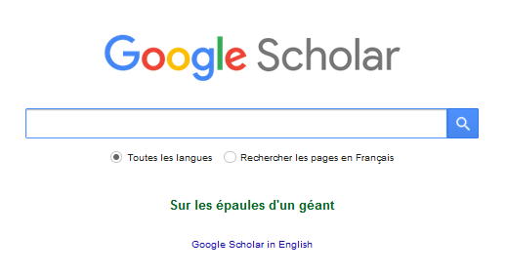
Easy to use and fast
Large coverage: international, multilingual
Free
Facilitates access to the full text
Citation index
- Opacity (Sources? Coverage?? Algorithm???)
- Affiliations?
- Citations of non-peer-reviewed documents
- Few advanced options

Slide 48
PROS | CONS
Specialized search engine set up in 2004, made up of bibliographic references from publishers and database trade producers or from magazines’ or Open Access portals (Hal) Eases access to the full-text document notably when it is in open access and includes around 400 million references | Limited basic search and advanced search which do not enable you to carry out complex search (Complex algorithms make this search engine operate in an opaque and unclear way). Impossible to set up a long equation or it would be cut off and badly interpreted.
Monitoring (alerts) and bibliometric tool, with an index of quotations, incorporated into the free software Harzing’s Publish Or Perish (POP) | Scientific validity and reliability of documents often questionable
Large international covering and search engine, more multilingual than Scopus | Truncation does not exist on Google, which is a major drawback.
It is a user-friendly freemium which encloses old reference documents helpful for a state-of-the-art | The access to the full-text document is not necessarily free of charge

Slide 49
Look it up in the online Scopus database
(“Machine Learning" AND state-of-the-art)
(microalloyed OR micro-alloyed) AND steel
Basic search query principles :
  Boolean operators, truncations, quotation marks for the exact phrase, use of parentheses
  Scopus is indifferent to upper or lower case (capital or small letters), to singular or plural and to accentuation or stressing
The other available functions
  Filters to screen, to limit by affiliation, by author, by topics, themes etc… (exclusion or limitation)
  Exporting bibliographical records
  Downloading the full-text document from the publisher’s website when the school has subscribed to the journal
  Setting up monitoring alerts,
  Saving searches

Slide 50
Espacenet (European Patent Office)
https://www.epo.org/searching-for-patents/technical/espacenet.html
Ressources Documentaires | Bibliothèques
Espacenet - Accueil
Search by keywords:
  Avoid smart search (too complex, in the field at the top of the screen)
  Prefer advanced search (easier, do not type quotation marks for a phrase in the field and choose « all »)
Avoid Classification search based upon the Cooperative Patent Classification System (too complex)
Ex ("washing machine" OR "washing machines") AND "machine learning“

Slide 51
Patents: the most profitable method of the session
Don't try to guess the correct classification code. Do the opposite.
1
Find a patent
Perform a keyword search in Espacenet and identify a single clearly relevant patent.
2
Read its CPC codes
Open its record and note the classification codes assigned to it, as well as the depositor and the family.
3
Restart using the code
Cross-reference CPC codes with keywords. The code captures patents written using vocabulary you would never have imagined, including in foreign languages.
4
Mapping a competitor
Run a follow-up search by depositor to see everything a specific company has filed regarding the domain.
5
Check the status
A patent that has lapsed or was never extended to Europe does not impose the same constraints. Check the legal status and geographical scope.
Point of law: it is the publication of an application that constitutes an opposable item of prior art, not the grant. An application abandoned ten years ago still destroys novelty.
Notes:
La même logique vaut pour les articles : partir d'un article pivot, lire ses termes d'indexation, les réinjecter. Le dire explicitement.

Slide 52
Quote sources
They allow the free use of protected content.
Creative Commons Licenses
4 modular components of your protection
BY: Attribution
NC: Non-commercial
ND: No derivatives
SA: Share-alike
3 things to keep in mind
- owning the copyright: you must control the rights to the work before licensing it.
- understanding irrevocability: a Creative Commons license cannot be revoked once published, even if you change your mind later.
- considering your goals: do you want to allow modifications? Commercial use? A share-alike requirement?

Slide 53
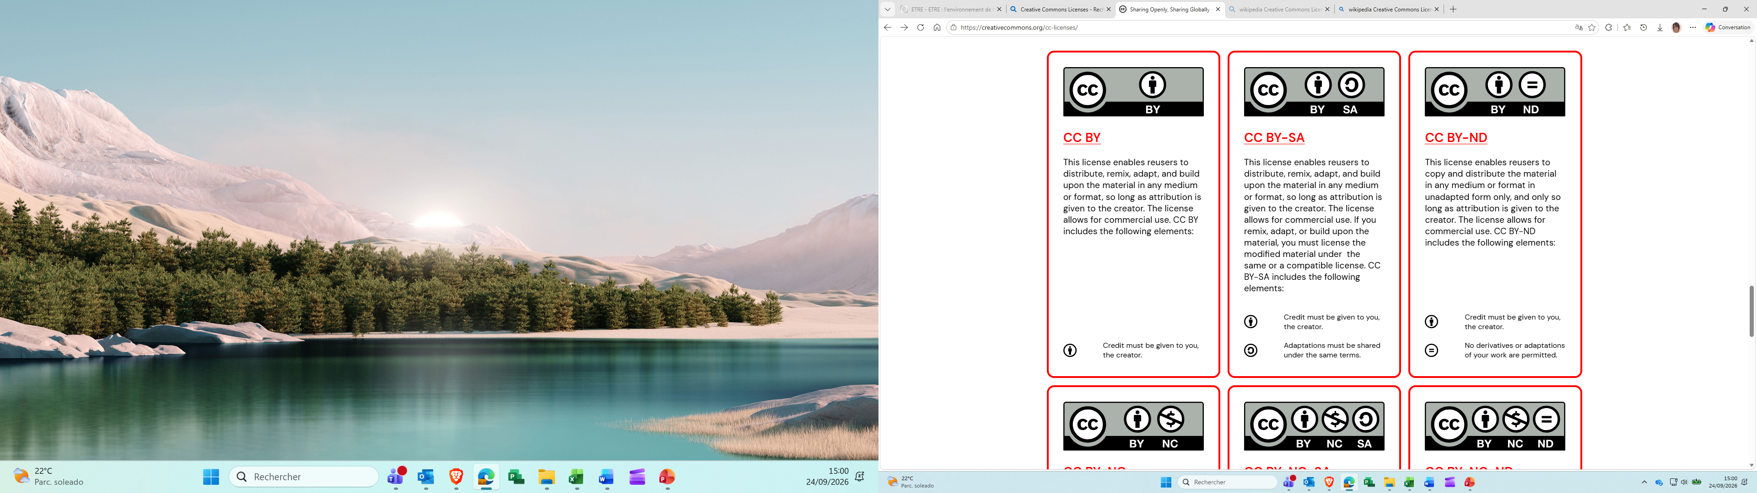
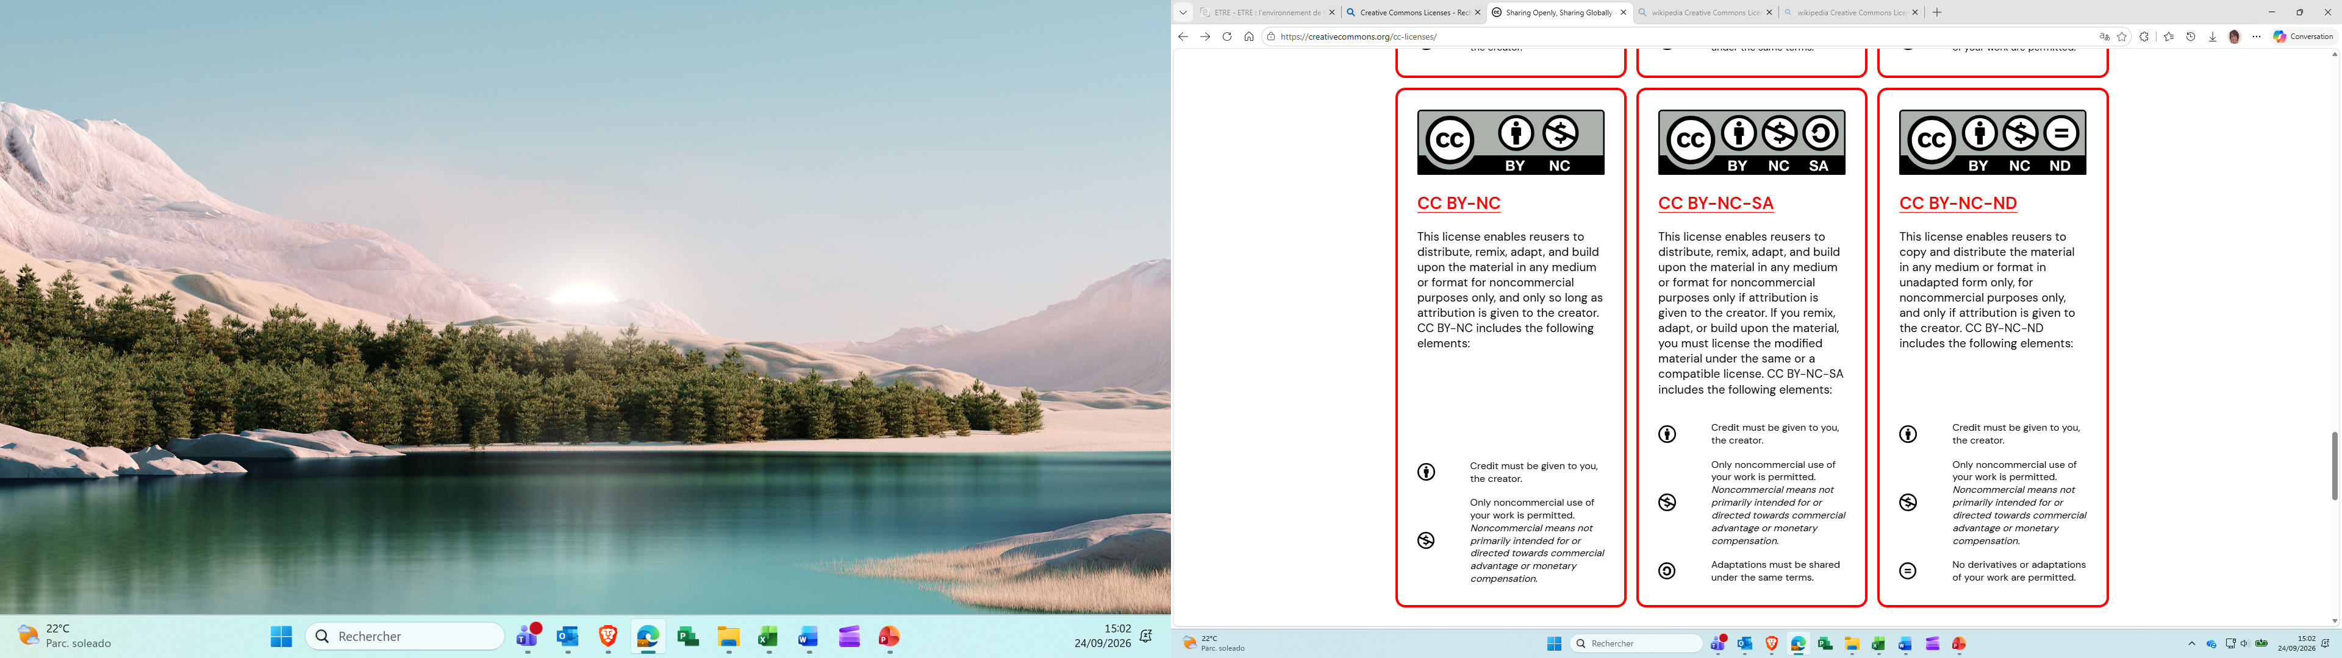
Quote sources
They allow the free use of protected content.
The CC Licenses
There are six different license types, listed from most to least permissive here:
Creative Commons Licenses
Creative Commons offers a License Chooser that allows you to select the license best suited to your needs.
Chooser - Creative Commons
Sources : Sharing Openly, Sharing Globally - Creative Commons

Slide 54




The two main orientations of open access
Free
Payment APC (Article Processing Charge)
(laboratory, établissement, negociations)
Open access Journal
DOAJ.org
€
€
€
The researcher decides where he/she wants to publish
Upload on an open archive -
institutional, national, thematic …
6 months embargo STM/12 months SHS
Subscription Journal
https://www.fun-mooc.fr/en/courses/open-science/
54

Slide 55


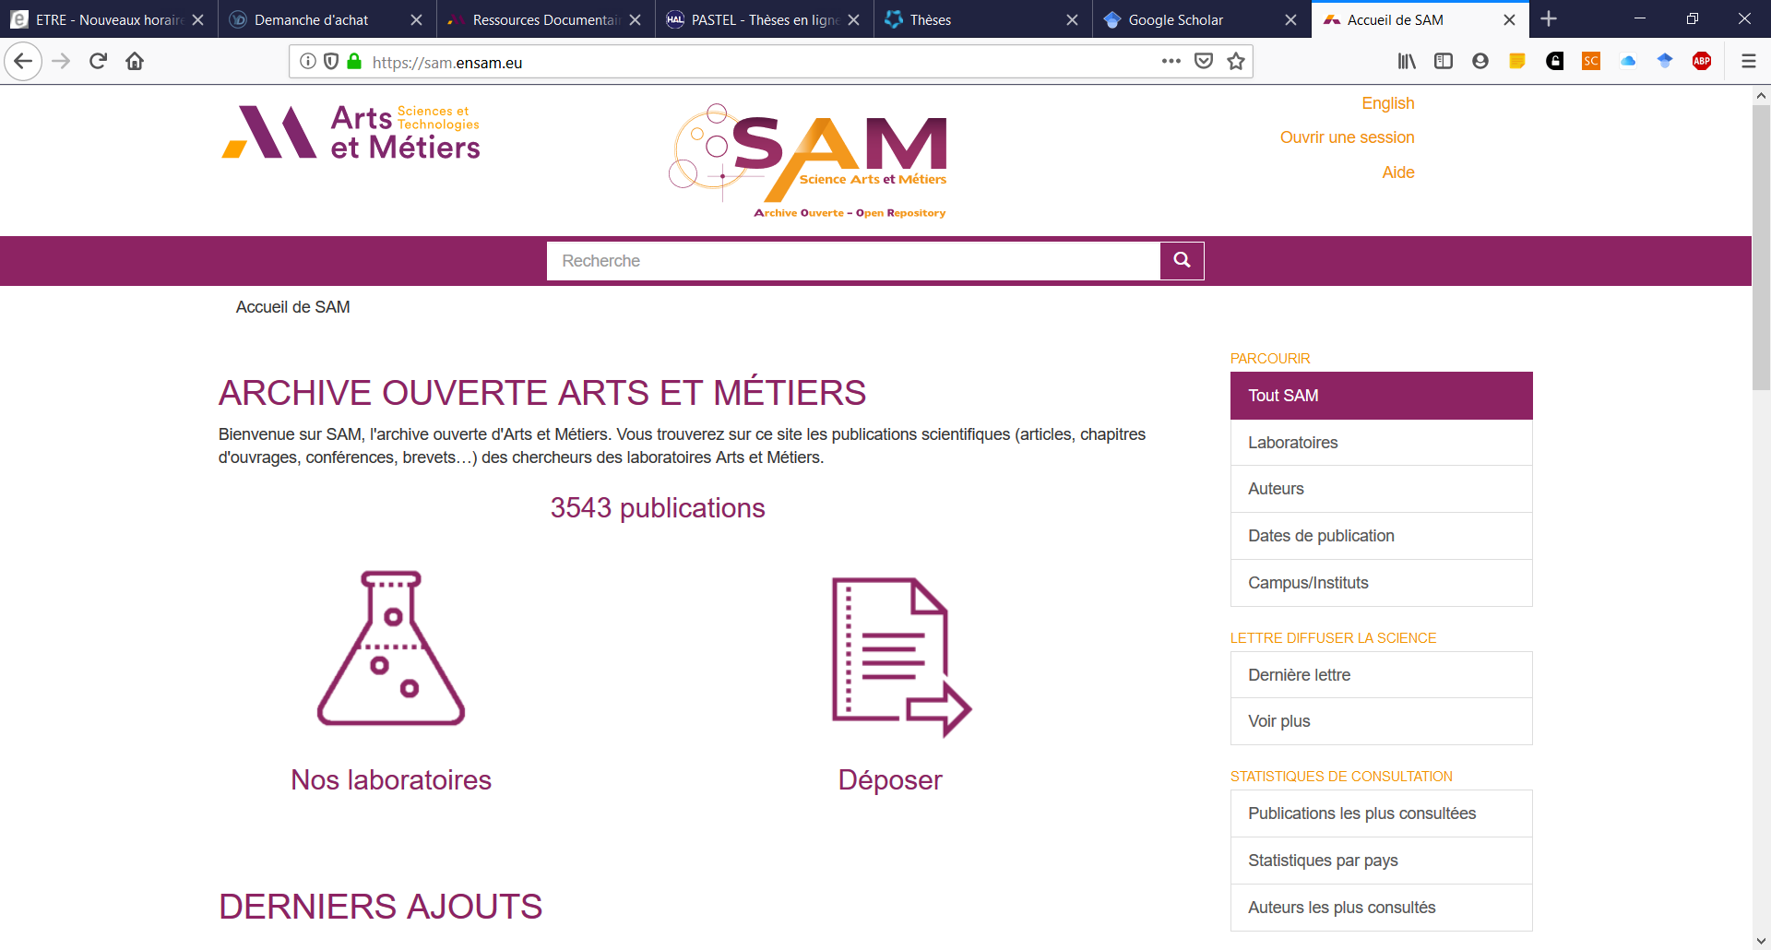
^{1. Open access archives}
https://hal.science/
Online Hyper article
Deposits by researcher or laboratory
French web site
2. Search engines with many indexes articles for free
https://www.base-search.net/
BASE is one of the world's most voluminous search engines especially for academic web resources.
more than 400 million records from more than 11,000 content providers.
access the full texts of about 60% of the indexed records for free (Open Access).

Slide 56
HAL (Hyper Article en ligne) https://hal.science/ | BASE (Bielefeld, Academic Search Engine) https://www.base-search.net/
French national scientific online multidisciplinary academic plateform, developed in 2001 by the CNRS published in French or in English, to be queried preferably in English Designed for deposit and dissemination of research articles whether published or not and of theses from French or foreign higher education or research establishments or from public or private laboratories. Use rather the basic search, since the advanced search is not very user-friendly Access to data is free but not necessarily their use or their reuse (Ask the author to entitle you to use or to reuse the data) | One of the search engines and world academic web resources the most considerable in volume to be queried preferably in English -Multilingual search in 20 languages Open and free access to full-text documents for 60 % of documents Browse the « advanced web » The search equation must not be too long as otherwise the results will not be relevant 2 cons : you cannot sort by affiliation and you cannot export a list of bibliographic records
Open science archives

Slide 57
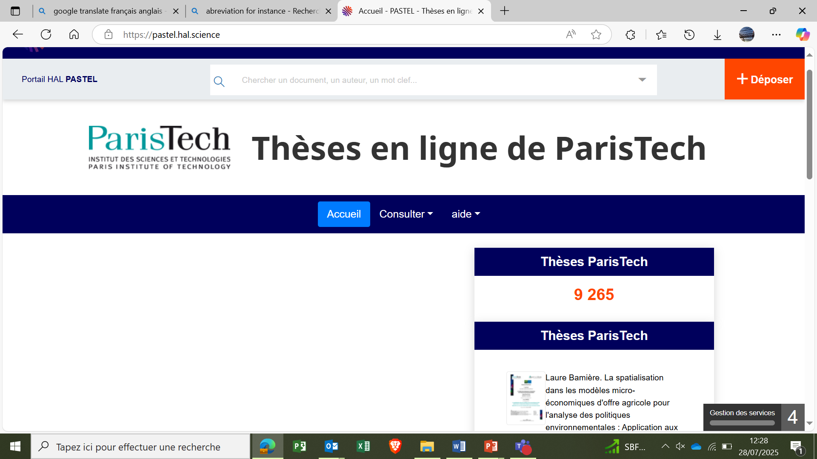

Open Science archives
Hal and Pastel theses from Paris Tech :
https://pastel.hal.science/
French thesis : http://theses.fr/

Slide 58
Where to search for press articles?
SUDOC catalogue (French theses)
THESES.fr
(French theses: defended or in preparation)
HAL
(French theses + articles)
MIT Theses (American theses) from Massachusetts Institute of Technologie)
Foreign theses (links on Abes websites : Selection of sites - Theses Network - abes.fr)

Slide 59

With Zotero, you can :
import and organize bibliographic references ;
edit a bibliography
Store pdf documents, web pages and other kinds of files
create notes and annotate your pdf
Exploit references with a text processor
Advanced functionalities
Zoterobib allows to create a bibliography with any device, no need to sign up : https://zbib.org/
Zoterogroup allows to share documents with other users : https://www.zotero.org/groups/
https://www.zotero.org/support/quick_start_guide
https://www.zotero.org/download/
Playlist Youtube Doctobib sur Zotero
Playlist Youtube de la bibliothèque de l'Université de Liège sur Zotero

Slide 60
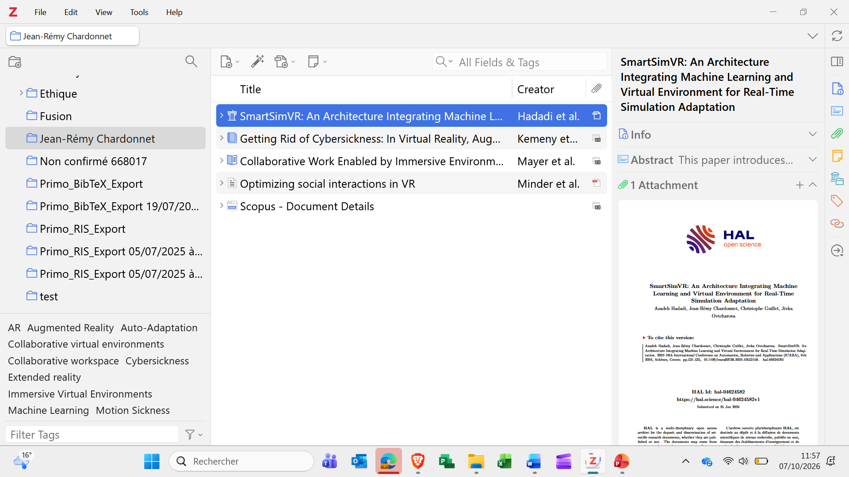

Slide 61
Zotero — the two misconceptions to avoid
BLOCK B · ZOTERO
A collection is not a folder
An attachment is stored as a copy
▪ The same reference lives in several collections without being duplicated.
▪ Removing it from a collection does not delete it from the library.
▪ Organising rule: collections follow the outline of the document to be written; tags carry status and inclusion criteria.
▪ Confusing the two produces a tree of fifty collections in which nothing can be found again.
▪ Never as a link to a local file.
▪ A link only works on the original machine — at group scale, that cannot be recovered.
▪ Quota trap: attachments in a group library count against the owner's storage, not that of whoever uploads them. Three hundred megabytes on a free account, used up fast.
▪ Each team chooses its strategy when the group is created.
Notes:
Show live that a reference lives in three collections without duplication. That is misconception number one, and thirty seconds of demonstration fixes it.

Slide 62
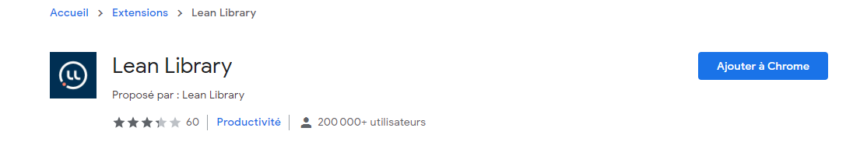
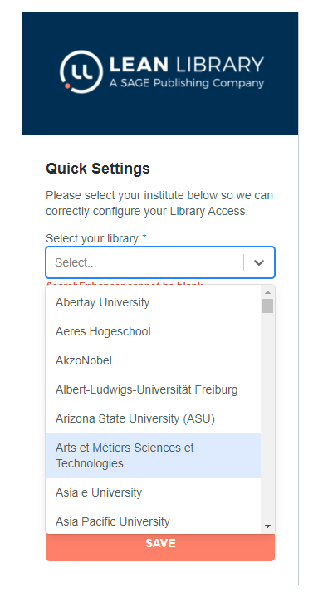
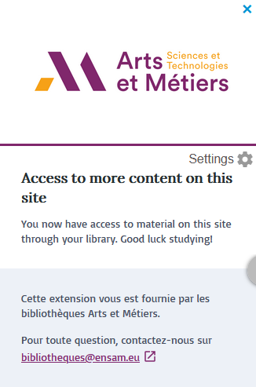
Browsers add-in Lean Library
Available on all browsers
Reports, identifies our subscriptions and redirects you to them through pop-ups
https://www.leanlibrary.com/download/
Lean Library is a browser extension that delivers your library’s resources and guidance directly into your student's online workflow — giving them seamless, legal access to millions of articles, eBooks, and open‑access content wherever they search.
Experience Lean Library extension – Lean Library
More information here :
: https://bibliotheques.ensam.eu/infosetservices/explorer-nos-ressources-facilement

Slide 63
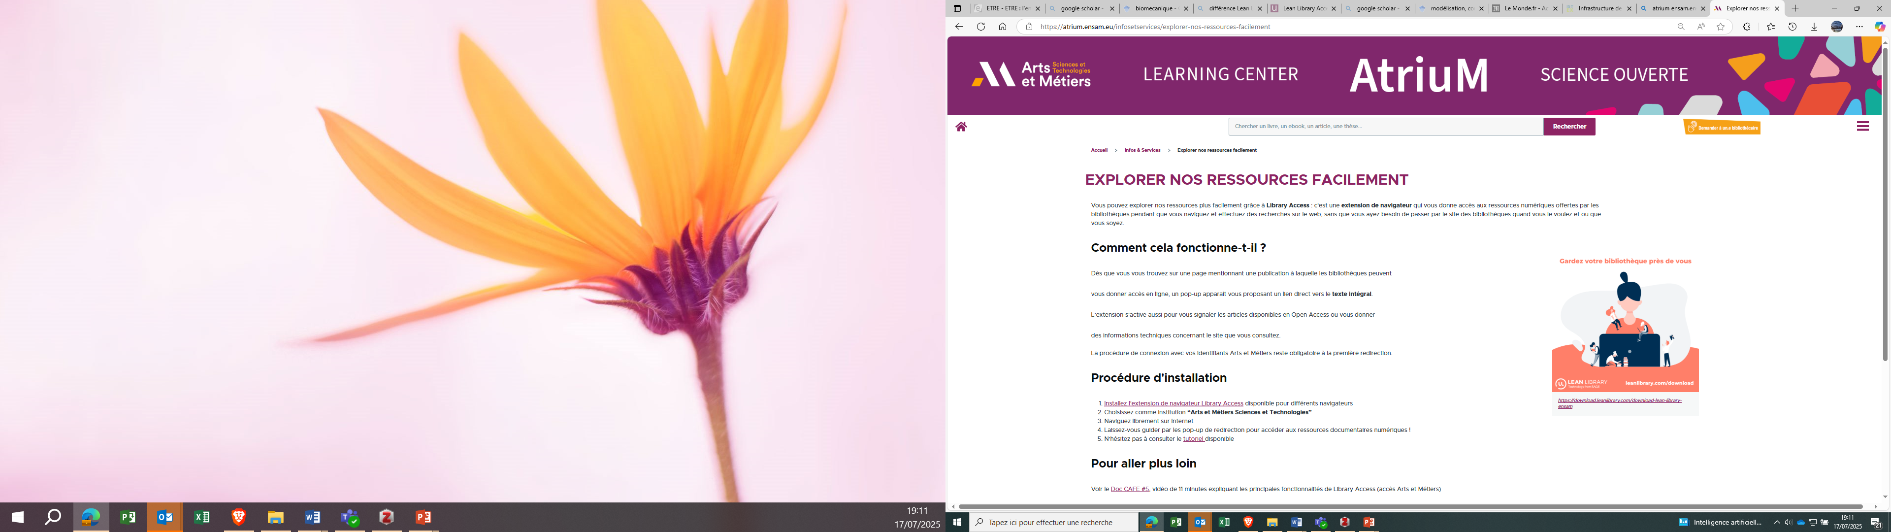
https://atrium.ensam.eu/infosetservices/explorer-nos-ressources-facilement

Slide 64
Other browser add-ins
Browser
Add-ins
to access
research documents
Unpaywall
https://unpaywall.org/
Core discovery
https://core.ac.uk/services/discovery
Lean library
https://www.leanlibrary.com

Slide 65
Exploring the world of research articles
Different kinds of research articles
How to read them
Sources and references

Slide 66
How to read a scientific article 1/3 ?
Different kinds of research articles
General paper (state of art) / specialized specific paper
Original Research
Review
Meta-analysis
Letter to editor
Case studies
Methodology or methods
Types of journal articles | Springer — International Publisher

Slide 67
How to read a scientific article 2/4 ?
^{What to pay attention to:}
The number of quotes on BD Scopus
Old article mentioned in many articles
probably a founding article
General paper (state of art) / specific paper
Author and/or laboratory recognized in the field
Relevant journal in the field
Your experience....
Study of a article:
Scopus – search « innovation engineer »
year 2025, 6th occurency
https://www-scopus-com.rp1.ensam.eu/pages/publications/105010112561

Slide 68
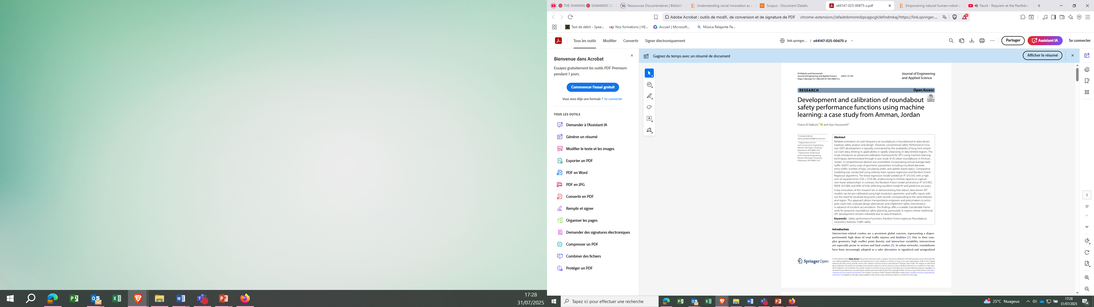
How to read a scientific article 3/4 ?
Why was this article put together? What decided its author to develop it?
What answer(s) does it provide to the problem?
What is the contribution of this answer to the advancement of the issue?

Slide 69
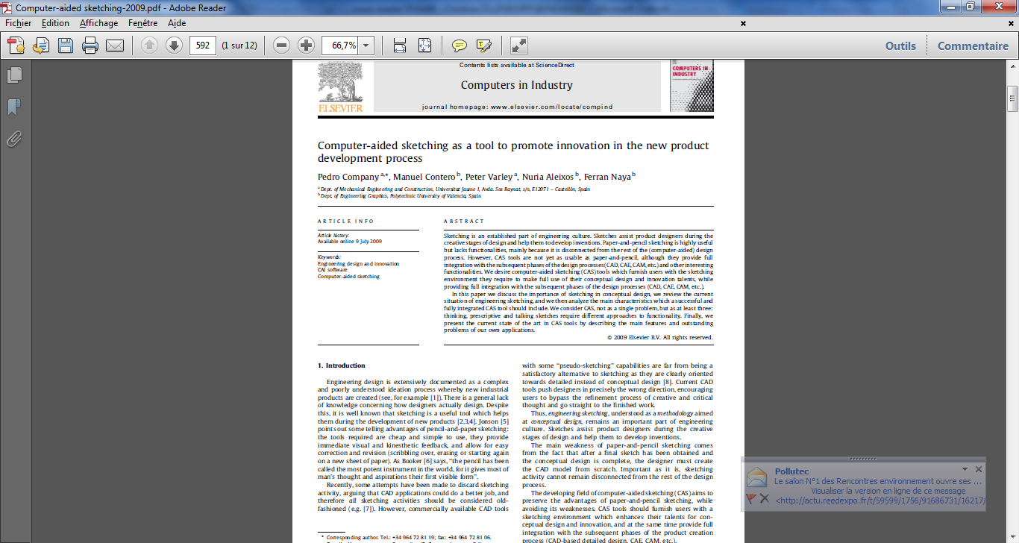
Identify the structure and features of the article and the author’s main points (see the highlights in ScienceDirect to insert in the reference of your bibliography).
Generate questions before, during, and after reading.
Take notes as you read.
Draw inferences based on your own experiences, knowledge and research.
See the impact of the Journal and the article (number of citations…)
Index it in your bibliographic base
How to read a scientific article 4/4 ?
Date of the article and/or publication (recent article? Has it already been published?)
Support and nature of the article (journal, book, magazine, collective work, conference, seminar, course....)
What type of text is it (original result, report, press release ....)
PDF : How to read a scientific paper
with a Template for Taking Notes on Research Articles

Slide 70

It is your turn!
Find the full text of this article so that we can study it :
Understanding social innovation as an innovation process: Applying the innovation journey model
Peter R.A.Oeij, Woutervan der Torre, FietjeVaas, StevenDhondt^{.-} Journal of Business Resarch vol 101, 2019.
You have 3 minutes.

Slide 71
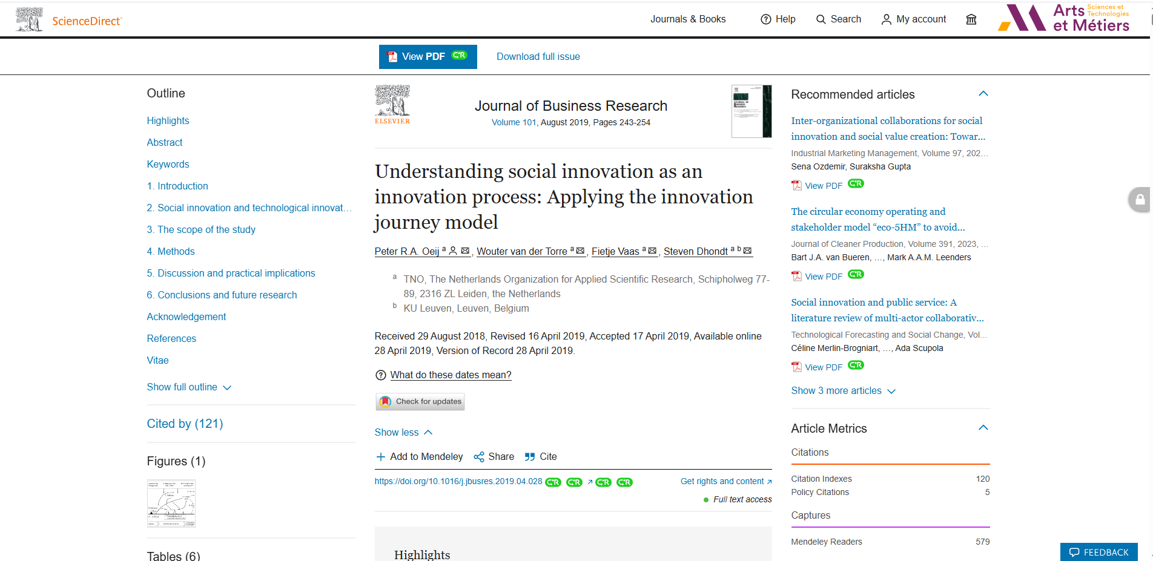
ScienceDirect

Slide 72
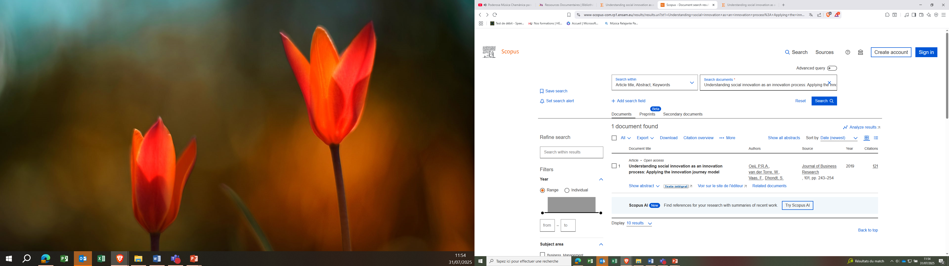
Scopus First step

Slide 73
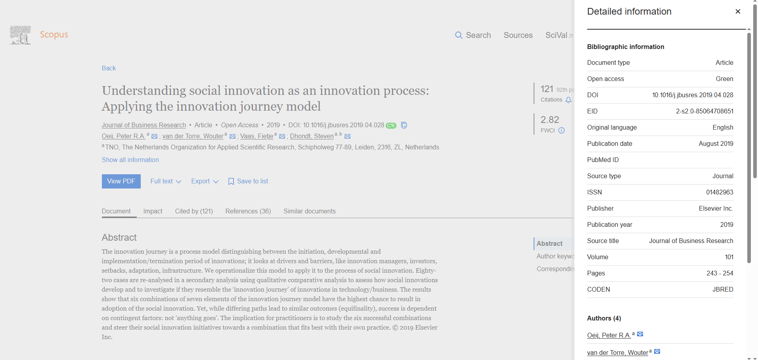
Scopus second step

Slide 74
The engineer's extraction matrix (non exhaustive)
Column | What is recorded there | Common trap
Subject studied | Material, process, architecture, algorithm | Wording too vague to be compared
Operating conditions | Temperature, pressure, scale, data set | The column most often skipped, and the most decisive
Metrics and value | The announced performance, with its unit. | A value recorded without its conditions is useless
Validation method | Simulation, banc d'essai, prototype, terrain | Simulation, test bench, prototype, field
Baseline | What the authors compare themselves to | Comparison to an outdated state of the art
Declared limits | What the authors themselves acknowledge | Can be found in the discussion, never in the summary
Maturity | Laboratory, pilot, industrial | The gap between the title and reality is often wide
Data and code | Available, on request, or unavailable | Conditions any future reuse
74

Slide 75
Critical reading: seven questions
1
Conditions
2
Metrics
3
Baseline
4
Répétition
Under what conditions was this result obtained, and how does it differ from actual use?
Is it standardized? Measured how? Two capacities measured differently can't be compared.
What are the authors comparing themselves to, and is this reference honest and up-to-date??
How many samples, cycles, repetitions? A single result is not a result.
5
Verifiability
6
Interests
Maturity
Reflex
6
7
Data and code available? If not, the result can't be verified — which doesn't make it wrong, but changes its status.
Who is funding it, what interests are at stake? The declaration is at the end of the article and is always read.
What real maturity, compared to what the title suggests?
These seven questions come up in the second round, at the same time as filling out the matrix. They don't take any extra time.
75

Slide 76
For now
I have tried to give you a bird’s eye view of bibliographic research methodology for you to carry out a good report in the STI field.
As a matter of fact the quality of your report depends mainly on the quality of your literature search.
Do you have other questions ?

Slide 77
Some orientations for a better use of AI for carrying out a bibliography

Slide 78
ChatGPT’s working principle and that of other AI search tools rely upon:
Conversational AI which enables the web user to « dialog » (and not only use keywords), to interact with the robot, or at least, to ask contextualized questions in natural language. The robot partly takes into account, the background of the issue raised.
Generative AI which enables the robot to produce contents (texts, sounds, still or animated pictures,) from existing data and to provide the most likely, probable, plausible, credible answers which are not necessarily true or faithful to reality.
3) The LLMs (Large Language Models) are deep learning and automatic models which train themselves on large bodies of data in order to try to understand the human language and to try to simulate human texts. Each LLM from each AI trains itself on a different corpus (GPT3,5 ou GPT4 for ChatGPT). The search results depend on the body and its quality.

Slide 79
Prompt
First and very important step
Communicating Effectively – Crafting Prompts - Université numérique - UNIGE

Slide 80
PROS | CONS
Free search and language assistant and robot, in its basic version, which enables the web user to interact with it, to ask questions in natural language The robot partly takes into account the background of the issue raised. | Is not a search engine. For the time being, it does not allow the assessment of documents or their sources, and does not enable the web user to browse « the hidden web »…
Helpful to prepare a state-of-the-art, your thesis or your dissertation, and your bibliographical researches by skimming through an issue and by determining the keywords of a lexical field | ChatGPT’s model language’s corpus has not been updated since 2021 and it exists only in English. The LLMs are not endowed with any intelligence, or understanding in the human sense. Therefore, it is crucial, in your question, to delimit the scope, the perimeter, the intervention field of the robot.
Tool for synthetising or analysing textual, sound and video documents) in order to make deliverables, summaries…. | This assistant produces the most likely, probable, plausible or credible answers which are not necessarily true or faithful to reality. When it does not know the answer, the robot makes it up from start to finish (One talks about «hallucinations » or « Invented answers »)
Assessment tool to make, for instance, a SWOT analysis (strengths, weaknesses, opportunities, threats) of a technology or of a research field Tool to learn the computing codes for trainees, future developers) Generator of a bibliography | This assistant often does not quote its sources and when it does so, it is, however, not necessarily feasible as they are often inaccurate, or even completely false.
ChatGPT
(Open AI)

Slide 81
Other powerful agents : Perplexity and Google Gemini
In which cases should you resort to ChatGPT, turn it to good account, and use it advisedly?
According to the authors of « Bases », a search or monitoring, using generative AI, to be relevant has to be confined to a very structured framework:
  Higly assessed contents and corpus which should be identified beforehand,
  Very precise and contextual (« prompts ») instructions,
  A human being who trains, coaches the robot, provides guidelines, confines the scope of its investigations, its activity field to get what he/she wants.
If ChatGPT has a role to play in information search, it is, above all, very upstream, during the keyword search stage or after sourcing, after the identification of sources and relevant information.
Perplexity is one of the most powerful AI search agents nowadays. Google Gemini, the Google AI agent is good too, Kagi search is also.of good quality.

Slide 82
Other AI tools
Scipace: summary of the five main articles, translation, summary of the sections of an article, Copilot Chat for each article
Concensus: focused on titles and abstracts of peer reviewed articles, « concensus metteur » : select the articles answering or the question or not. Quartile of the different journals in which these publications are made, and in the summary it provides here, it will cite each statement or remark accordingly by directing us to the article.
ResearchRabbit and Connected Papers: for cartography of quotations and semantic network.
Scite: actually analyzes the text of scientific articles to determine how they cite each other.
Citation score : supporting contrasting ou mentioning article, Impact factor, work with publisher
Apertus: Swiss AI Initiative in collaboration between EPFL, ETH Zurich, and CSCS
compar: IA, Conversational IA Comparator

Slide 83
Other AI tools
Claude by Anthropic : very good for code and sciences
Grok (from Elon Musk, XAI) : create an account
Deepseek : create an account
Mistral (french tools): very good AI, doesn’t keep the documents (unlik Open AI)
Quant+: with integrated AI that does not keep searches
https://www.gref-bretagne.com/ressources/replay-inspiration-formation-un-parcours-mille-chemins-lia-booste-la-formation/

Slide 84
Format a bibliography
Example : Google Scholar → Click “Cite” below a paper to get preformatted citations in several formats.
Check the data !
InfoTrack : Assess GenAI output using “lateral reading”
1. Use Tools to Format Citations
AI tools can automatically generate formatted citations.
Possibility of using Zotero, a free Open source software to export, to transfer the references and to carry out a bibliography Zotero (with Zotero AI plugin) or ZoteroBib: zbib.org
Zotero
To avoid errors, use tools that automatically extract metadata: Zotero + AI Plugins
Add extensions like Zotero GPT to enhance descriptions.
Drag and drop a PDF: Zotero automatically retrieves the title, author, etc.
ZoteroBib Quick online version: https://zbib.org
Paste a DOI, ISBN, URL, or title of a book or article → it generates the reference in the chosen style.

Slide 85
EndNote Click Click Extension that identifies accessible PDFs and creates bibliographic references.
- CiteThisForMe
- Mendeley Elsevier tool with automatic recognition of references. Works with a Word plugin to insert citations.
2, Use Citation Extensions with AI
There are browser extensions that use AI to manage references automatically:
ResearchRabbit / Connected Papers make it possible to find relevant sources with suggestions based on a topic → then generate the bibliography with Zotero or ChatGPT.
Scite.ai : use AI to show how a source is cited (positively, negatively, or neutrally). Also provide the formatted citation.
Scribbr (www.scribbr.fr) → Free quote generator (APA, MLA).
MyBib (www.mybib.com) → Create bibliographies in just a few clicks.
Grammarly or QuillBot : Check the reliability of the references.
3. One of the possible methods
Collection: Find sources with many tools
Verification: compare various AI, check the sources and the processes of AI
Extraction: Import them into Zotero/Mendeley.
Generation: Use ZoteroBib or Scribbr to format.
Verification: Pass the references through ChatGPT for proofreading.
Insertion: In Word or LaTeX, use the Zotero/Mendeley plugin.

Slide 86
Who?
Who is he? What is his status? His area of ​​expertise? His reputation? Referral network? His point of view? His motivations?
Evaluate sources
Questions to keep in mind
What?
- Is the information true, accurate, and verifiable? - Is the information written clearly and without errors? - Does it involve approximations or exact values?
Why?
- Is the goal to provide information neutrally? - Is the information written clearly and without errors? - Does it involve approximations or exact values?
How?
- Is there a bibliography? - Are the cited sources reliable and verifiable? - Is the methodology explained? - Has the publication undergone peer review?
When ?
- Is the publication or update date recent? - Is the information still current in relation to your topic?

Slide 87
Some fact-checking tools to help:
News —all dedicated to combating misinformation. :
Decodex (by *Le Monde*'s "Les Décodeurs"),
AFP Factuel ,
France 24's *The Observers*,
Hoaxbusters french platform
You can test your critical thinking skills here:
Images: TinEye, for tracing the origin of an image.
A browser extension for spotting fake news: InVID & WeVerify.
As a general rule, strive for objectivity.

Slide 88
What AI changes, what it breaks
INTRODUCTION · 1 H
What genuinely changes
What degrades
▪ Rephrasing a still-vague need and drawing the vocabulary out of it.
▪ Searching by meaning rather than by exact word.
▪ Crossing the language barrier effortlessly.
▪ Extracting a structured comparison across dozens of PDFs.
▪ Screening a first pass over several hundred records.
▪ Fabrication of plausible, non-existent references.
▪ Silent rewriting of the query: you lose control of recall.
▪ Corpus opacity: you do not know what was not looked at.
▪ Illusion of exhaustiveness: a well-written answer looks complete.
▪ Misattribution: the source exists, but it does not say that.
88

Slide 89
Why published rankings are not enough
Three reasons never to rely on it alone
1
Conflict of interest
2
Editorial fragility
3
Failure to control variables
The most frequently cited comparison pitting three major commercial tools against one another is published by the vendor of one of the three—which emerges as the winner. The methodology is not necessarily dishonest; it is simply designed by an interested party.
An academic evaluation of these same tools, published in an information science journal, has been retracted. A published and cited article is not a reliable article.
Comparing two tools without controlling for the underlying model, cost, and access to resources amounts to no comparison at all. This criticism led to the creation of AstaBench, a scientific agent evaluation suite that does control for cost and tooling.
You don't just read a ranking; you re-measure based on your own specific question.
89

Slide 90
THE CENTERPIECE
Without a reference corpus, you only measure what a tool has found. With one, you measure what it has missed.
A gold-standard corpus is a set of references known—independently of any tool—to be relevant. Yours consists of twenty-five DOIs extracted from the bibliography of a literature review on the demonstration topic. And it is silence—never noise—that causes a state-of-the-art review to fail.
90

Slide 91
Four families, four failure modes
Classify by function rather than by brand: products are renamed every year, structural flaws do not move.
Family | Characteristic failure mode | Open representatives
Semantic search and sourced answers | Partial, rarely documented indexed corpus: you do not know what was not looked at | OpenAlex, Semantic Scholar, OpenScholar
Multi-step research agents | Silent rewriting of the question, illusion of exhaustiveness | local-deep-research, GPT-Researcher
Querying your own corpus | Knows nothing you did not give it: the silence is entirely yours | PaperQA2, AnythingLLM, Open WebUI
Screening and mapping | Reproduces and amplifies the bias of the corpus supplied; a map is never evidence | ASReview, VOSviewer, bibliometrix
91

Slide 92

Watch out !
AI can make a lot of mistakes, always check information
Short list of questions to ask to evaluate the quality of an AI tool for literature review
Reliability and perimeter of sources
How does the tool process and analyze the data? Transparency and rigor
Reputation of the tool among universities and specialized institutions
features for specific needs
AI = one’s work
AI = help and/or complement to one's work

Slide 93
Write the state of the art
1
Scope and method
The question, the inclusion criteria, the sources consulted, what is deliberately excluded. Half a page that makes everything else credible.
2
Domain structuring
What major approaches exist, according to what classification criteria. This is where mapping comes in, if it has been done.
3
Comparative analysis
The approaches compared based on the criteria of the extraction matrix, along with their conditions of validity.
3
4
3
Locks and gaps
What isn't solved, not measured, what the results contradict. The part that has the most value — and the one you'll write the least.
5
3
Positioning
Where your work fits into this landscape.
93

Slide 94
WHAT TO TAKE WITH YOU
The tools will change,
the method will remain.
Three practices will outlast everything you saw today:
breaking a question into facets and writing a query someone else can replay;
keeping a log of what you searched;
never letting a reference in without having checked that it exists, that it really says that, and that it is the right source.
94

Slide 95

Many thanks
A question? Send me an e-mail at :
carole.wahnoun@ensam.eu

